Slide 1
Ecommerce Application Case Study Hexaware Technologies | Java Training Program Presented by: N Lohith Reddy

Slide 2
Introduction
Objective: To develop a console-based Ecommerce Application using Java and MySQL, applying object-oriented principles and database connectivity.
Goal of the Case Study:
Implement core Java features in a real-world project.
Learn to interact with a database using JDBC.
Practice exception handling and modular programming.
Tools & Technologies Used:
Java
MySQL (Database)
JDBC (Java Database Connectivity)
VS Code (IDE)

Slide 3
Project Architecture
entity/ – Contains model classes like Customer, Product, Cart, Order, OrderItem.
dao/ – Data Access Layer: Interface and Implementation to interact with the database.
util/ – Utility classes for reading DB properties and creating DB connections.
myexceptions/ – Custom exception classes for handling invalid customer/product/order IDs.
app/ – Contains the main class EcomApp.java with menu-driven logic.
db.properties – Configuration file with database connection details.

Slide 4
Objectives
Develop a touchless GUI using hand gestures and eye movements for seamless control.
Enhance accessibility for users with physical disabilities and limited mobility.
Provide an intuitive, natural interaction method for diverse users (e.g., hands-free needs).
Evaluate system performance in gesture recognition and eye-tracking accuracy.
Improve user experience and efficiency through customizable gesture commands.
Contribute to inclusive technology design for broader digital participation.

Slide 5
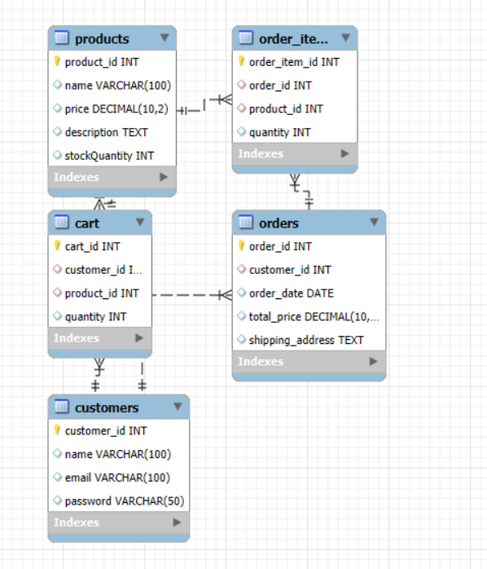
Database Design

Slide 6
Key Functionalities
Customer Management
Register a new customer
Delete customer by ID
Product Management
Add new products
Delete existing products
Cart Management
Add products to cart
Remove products from cart
View all products in cart
Order Management
Place an order from cart
Store order details (products, quantity, total price, shipping address)
View past orders by customer

Slide 7
Java Concepts Used
Object-Oriented Programming
Classes and Objects for entities like Customer, Product, Order, etc.
Encapsulation with private fields and getters/setters
Interfaces and Implementation in the DAO layer
Exception Handling
User-defined exceptions: CustomerNotFoundException, ProductNotFoundException, etc.
Try-catch blocks to handle SQL and logic errors
Control Flow & Loops
Used in menu-driven app (EcomApp.java)
Looping through cart items and order lists
Collections
List<Product> for cart display
List<Map<Product, Integer>> for order items
JDBC Integration
Connect to MySQL using PreparedStatement
Perform CRUD operations using SQL queries

Slide 8
Thank you.

